Slide 1
Zillow Home Value Prediction
Minjung Koo
Feb 23, 2019

Slide 2
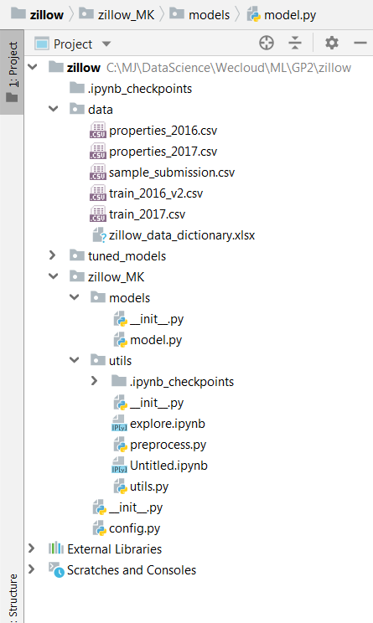

Slide 3
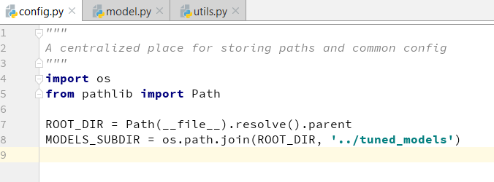
1. Congif.py

Slide 4
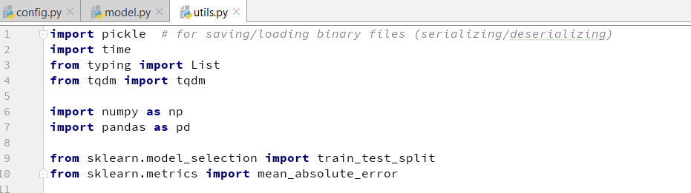
2. Utils.py

Slide 5
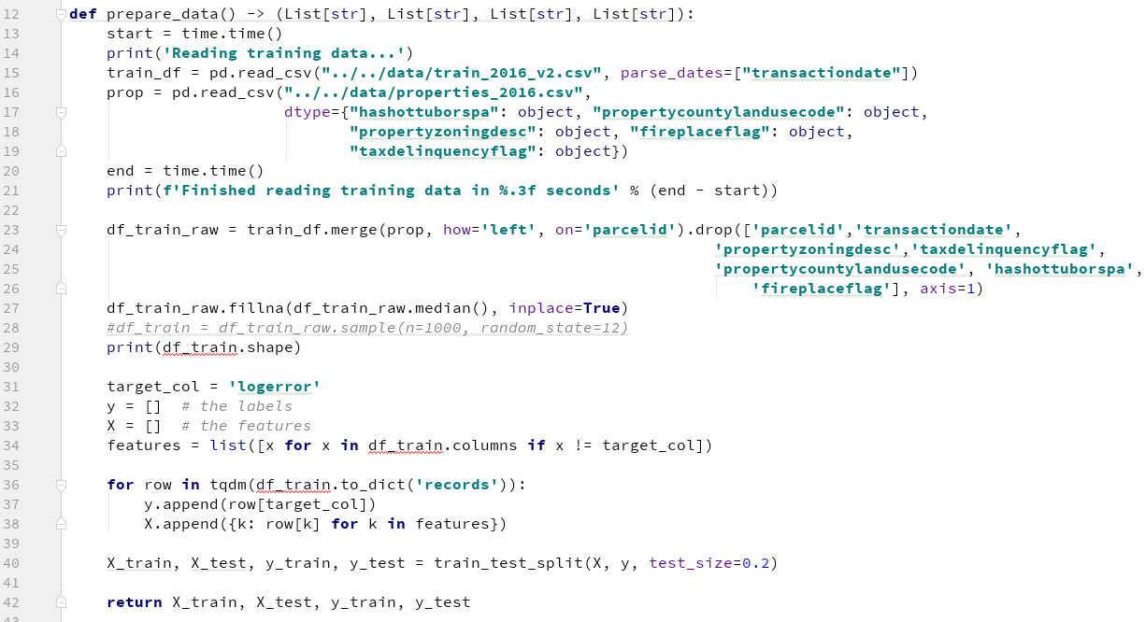
2. Utils.py
Drop categorical features, and impute

Slide 6
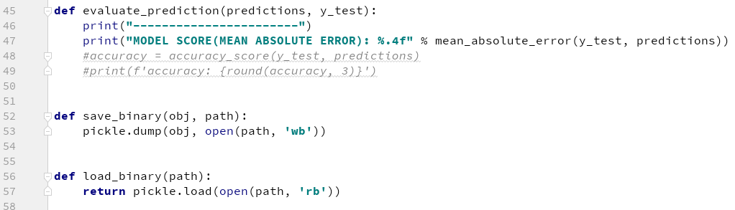
2. Utils.py
Mean Absolute Error to evaluate
Saving the models

Slide 7
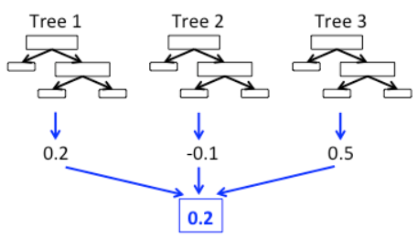
3. Model.py
RandomForeseRegressor:
The random forest model is a type of additive model that makes predictions by combining decisions from a sequence of base models. More formally we can write this class of models as:
g(x)=f0(x)+f1(x)+f2(x)+...

Slide 8
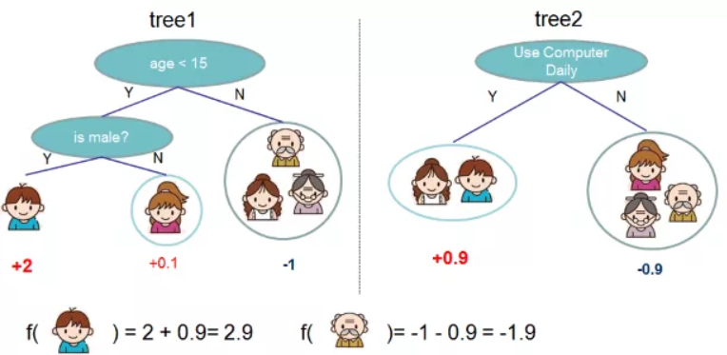
3. Model.py
XGBoost
(eXtreme Gradient Boosting):
Gradient boosted decision trees. engineered to exploit every bit of memory and hardware resources for tree boosting algorithms. Therefore:
memory efficient (faster than RF)
high accuracy

Slide 9
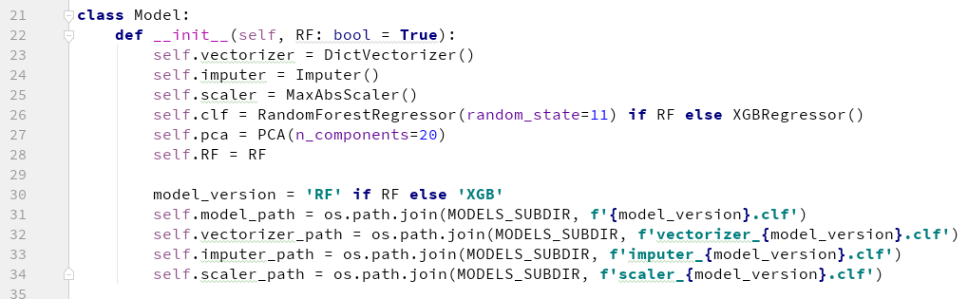
3. Model.py

Slide 10
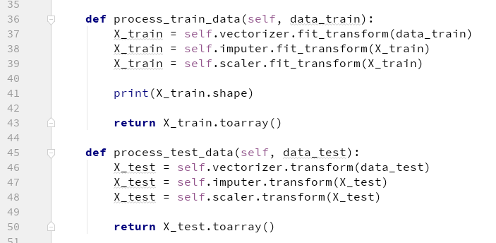
3. Model.py
X_test.toarray()
to apply PCA

Slide 11
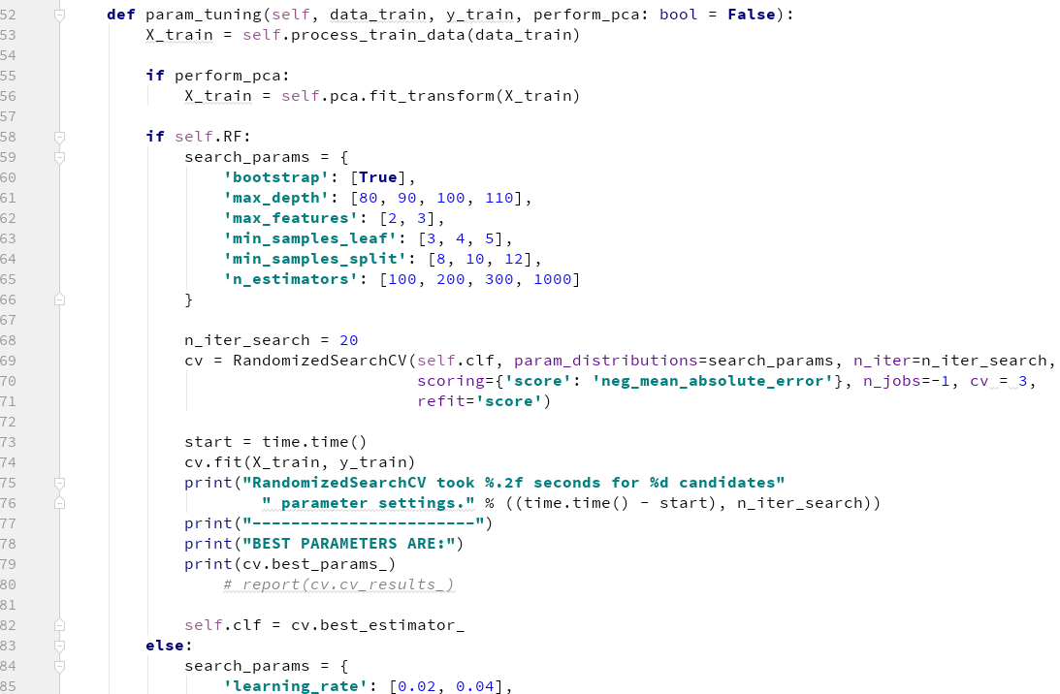
3. Model.py
from here

Slide 12
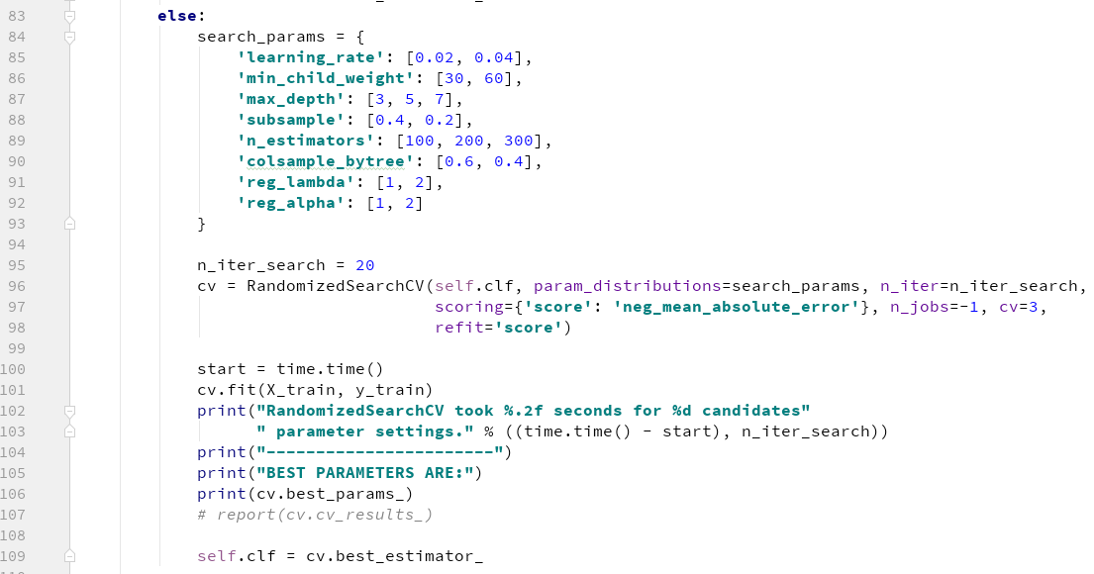
3. Model.py

Slide 13
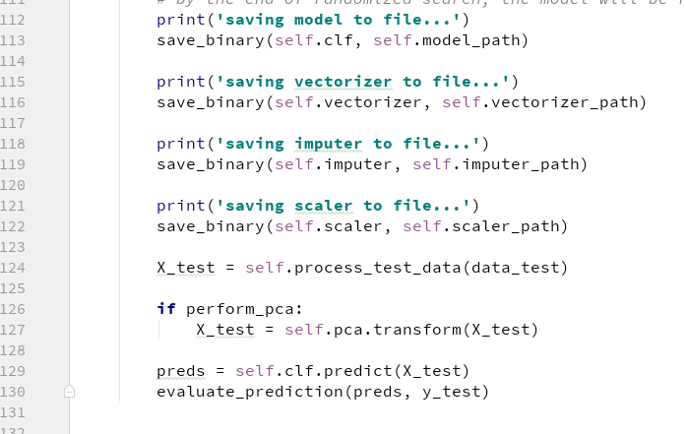
3. Model.py

Slide 14
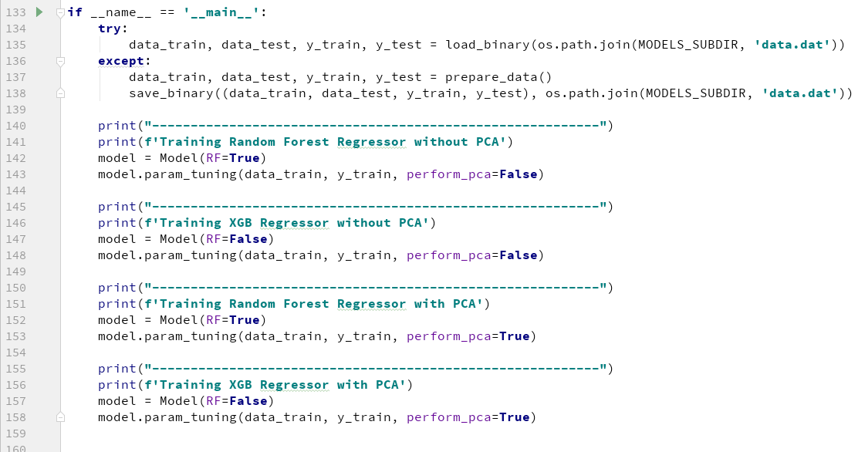
3. Model.py

Slide 15
4. Results – without PCA
Reading training data... Finished reading training data in 10.227 seconds (90275, 53) 100%|██████████| 90275/90275 [00:00<00:00, 260885.09it/s] ---------------------------------------------------------- Training Random Forest Regressor without PCA /tmp/zillow/venv/lib/python3.5/site-packages/sklearn/utils/deprecation.py:58: DeprecationWarning: Class Imputer is deprecated; Imputer was deprecated in version 0.20 and will be removed in 0.22. Import impute.SimpleImputer from sklearn instead. warnings.warn(msg, category=DeprecationWarning) (72220, 52) RandomizedSearchCV took 410.01 seconds for 20 candidates parameter settings. ----------------------- BEST PARAMETERS ARE: {'n_estimators': 1000, 'max_features': 2, 'min_samples_leaf': 5, 'max_depth': 90, 'bootstrap': True, 'min_samples_split': 8} saving model to file... saving vectorizer to file... saving imputer to file... saving scaler to file... ----------------------- MODEL SCORE(MEAN ABSOLUTE ERROR): 0.0673

Slide 16
4. Results – without PCA
Training XGB Regressor without PCA /tmp/zillow/venv/lib/python3.5/site-packages/sklearn/utils/deprecation.py:58: DeprecationWarning: Class Imputer is deprecated; Imputer was deprecated in version 0.20 and will be removed in 0.22. Import impute.SimpleImputer from sklearn instead. warnings.warn(msg, category=DeprecationWarning) (72220, 52) RandomizedSearchCV took 116.16 seconds for 20 candidates parameter settings. ----------------------- BEST PARAMETERS ARE: {'n_estimators': 300, 'reg_lambda': 2, 'subsample': 0.4, 'learning_rate': 0.02, 'max_depth': 3, 'reg_alpha': 1, 'colsample_bytree': 0.4, 'min_child_weight': 60} saving model to file... saving vectorizer to file... saving imputer to file... saving scaler to file... ----------------------- MODEL SCORE(MEAN ABSOLUTE ERROR): 0.0676

Slide 17
4. Results – with PCA
Training Random Forest Regressor with PCA /tmp/zillow/venv/lib/python3.5/site-packages/sklearn/utils/deprecation.py:58: DeprecationWarning: Class Imputer is deprecated; Imputer was deprecated in version 0.20 and will be removed in 0.22. Import impute.SimpleImputer from sklearn instead. warnings.warn(msg, category=DeprecationWarning) (72220, 52) RandomizedSearchCV took 605.07 seconds for 20 candidates parameter settings. ----------------------- BEST PARAMETERS ARE: {'n_estimators': 300, 'max_features': 2, 'min_samples_leaf': 4, 'max_depth': 100, 'bootstrap': True, 'min_samples_split': 12} saving model to file... saving vectorizer to file... saving imputer to file... saving scaler to file... ----------------------- MODEL SCORE(MEAN ABSOLUTE ERROR): 0.0700

Slide 18
4. Results – with PCA
Training XGB Regressor with PCA /tmp/zillow/venv/lib/python3.5/site-packages/sklearn/utils/deprecation.py:58: DeprecationWarning: Class Imputer is deprecated; Imputer was deprecated in version 0.20 and will be removed in 0.22. Import impute.SimpleImputer from sklearn instead. warnings.warn(msg, category=DeprecationWarning) (72220, 52) RandomizedSearchCV took 70.68 seconds for 20 candidates parameter settings. ----------------------- BEST PARAMETERS ARE: {'n_estimators': 300, 'reg_lambda': 2, 'subsample': 0.4, 'learning_rate': 0.02, 'max_depth': 3, 'reg_alpha': 2, 'colsample_bytree': 0.4, 'min_child_weight': 60} saving model to file... saving vectorizer to file... saving imputer to file... saving scaler to file... ----------------------- MODEL SCORE(MEAN ABSOLUTE ERROR): 0.0679

Slide 19
4. Summary
Dimension Reduction to 20 features (from 52)
Model | RF | XGB | RF (PCA) | XGB (PCA)
Time | 410.01 | 116.16 | 605.07 | 70.68
MAE | 0.0673 | 0.0676 | 0.0700 | 0.0679
Best!
(strong performance, and significantly faster)

